Slide 1
CH 6: Organize your Speech
Brandon straight

Slide 2
Why does Organization matter
Help guide the speech preparation process
Help your audience understand & remember your speech
Help establish your credibility

Slide 3
Develop your main points
Select your main points
Limit the number of points
Focus on your audience

Slide 4
How to prepare a main point
Parallel wording for each main point

Slide 5
Organizational Patterns
Chronological pattern
Spatial pattern
Topical pattern
Problem-Solution pattern
Cause-Effect/Effect-Cause pattern
Notes:
Spatial-an organizational pattern for speeches in which the main points are arranged according to movement in space or direction
topical pattern- divides the speech into topic and then subtopics

Slide 6
Introductions
Attention getter
Stat, quote, brief story, question
https://www.youtube.com/watch?v=vYqsSD2Nvl4&ab_channel=RuthSong
Establish speaker-audience-topic relationship (RTL)
Orient the audience
Give a general idea of subject
Identify main points
Detailed preview
Notes:
Establishing credibility, refer to others present, express personal connection to the topic, pleasure in speaking, compliment the audience, express similarities with audience
Orient the audience- give a general idea of subject, identify main points, detailed preview, and identify goal

Slide 7
Conclusions
Summarize
Restate main points
Restate thesis
Motivate
Ask for a response
Reiterate importance of the issue
Provide Closure
Refer to upcoming events
Refer to introduction or thesis

Slide 8
Transitions
Connectives
Now that we have a general idea we can examine ___ in more detail.
Preview/Reviews (internal summaries/previews)
Summarize briefly what you have already said and preview whats next
Signposts
Tell where you are in your speech or if something very important is coming
First, next, etc. Or. This next section is important to understand why ___ is important

Slide 9
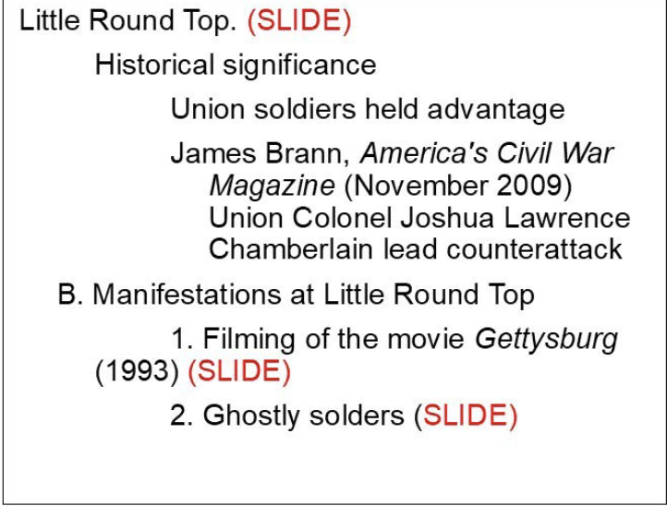
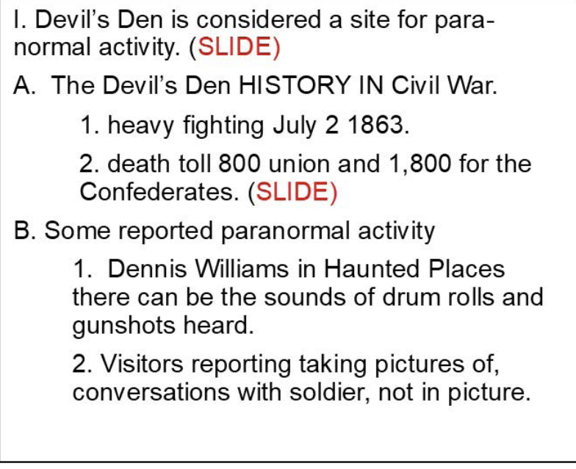
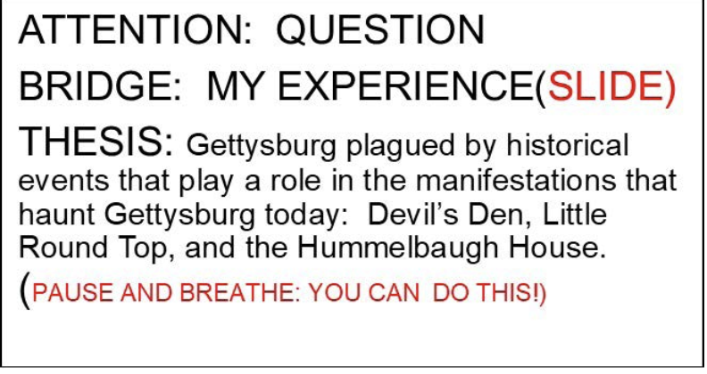
Speaking Outlines
What to put on note cards pg. 107

Slide 10
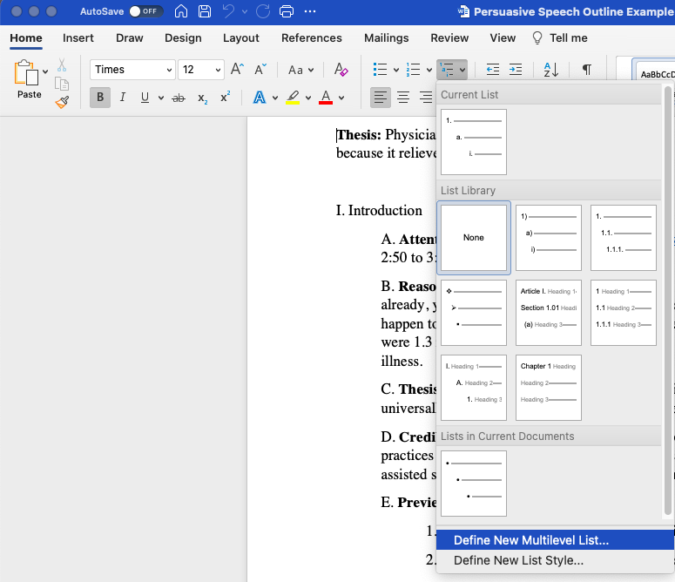
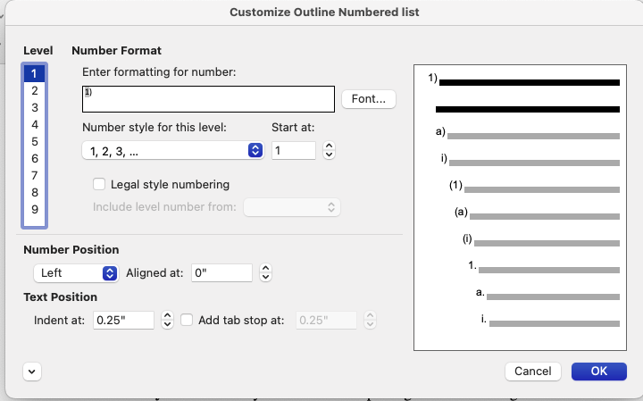
Symbols and how to do make them do what you want

Slide 11
The correct Symbols and Order
II.
A.
1.
a.
b.
i.
Transition:
B
1.
a.
i.

Slide 12
How to make outlines
Tim Swift
Persuasive Speech Outline
Professor Straight
Topic: Physician-assisted suicide
Audience: I am speaking to a Communications 101 class that consists of mostly freshmen. The students are generally between the ages of eighteen and twenty, although there are a few older students present.
General Purpose: To persuade
Specific Purpose: To persuade my audience that physician-assisted suicide is morally justifiable.
Thesis: Physician-assisted suicide is morally justifiable, and should be universally legalized, because it relieves the suffering of those in pain.

Slide 13
How to make outlines cont.
I. Introduction
A. Attention-getter: https://www.youtube.com/watch?v=J_EKwSXOsVE&t=346s - 2:50 to 3:22
B. Reason to listen: Chances are, if you haven’t known someone with a terminal illness already, you will sometime in your life. And it’s scary to think about, but it may even happen to you. According the Centers for Disease Control and Prevention, in 2013, there were 1.3 million hospice patients, most of whom were dying from a chronic or terminal illness.
C. Thesis statement: Physician-assisted suicide is morally justifiable, and should be universally legalized, because it relieves the suffering of those in pain.
D. Credibility statement: My interest in this topic began when learning about end of life practices in a previous class. In addition, I did a large amount of research on physician-assisted suicide (which I may refer to as PAS) for this speech.
E. Preview of main points:
1. First, I will explain what physician-assisted suicide is.
2. Second, I will describe the legal aspects of physician-assisted suicide.
3. Finally, I will explain how physician-assisted suicide is beneficial for suffering families.

Slide 14
activity
Design outlines on white boards
Chose a random topic maybe it is one you will use maybe it is one you wont it does not matter the purpose is to learn how to make the structure
Provide Name, Instructor name, Type of speech
Introduction components
Rough draft of what you would say in the body
Choose one topic and all of you work on it together

